Slide 1

Calendar+
Update
Authors: Chad Kinnard, Bo Yang Li, Tyler Marrapese, Warren Overstreet

Slide 2
Calendar+ Recap
Calendar+ is a dynamic web application with which the user can create his/her own schedule.
Like any standard calendar web app, the user will be able to create events on any desired valid date.
Windows 10, Chrome browser

Slide 3
Outline
GUI
Changes
What’s been completed
Partially Completed
Still to be completed
Potential Issues
Node.js Modules - Changes
Node.js HTTP Requests (backend)
Currently implemented
To be implemented
Displaying Events
Events/Reminders
Server Hosting

Slide 4
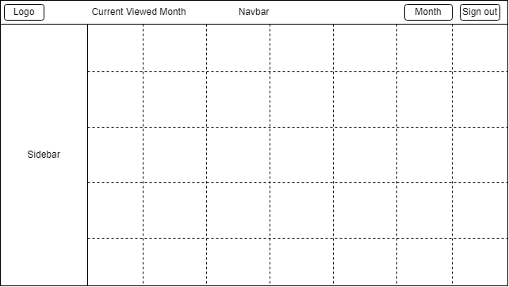
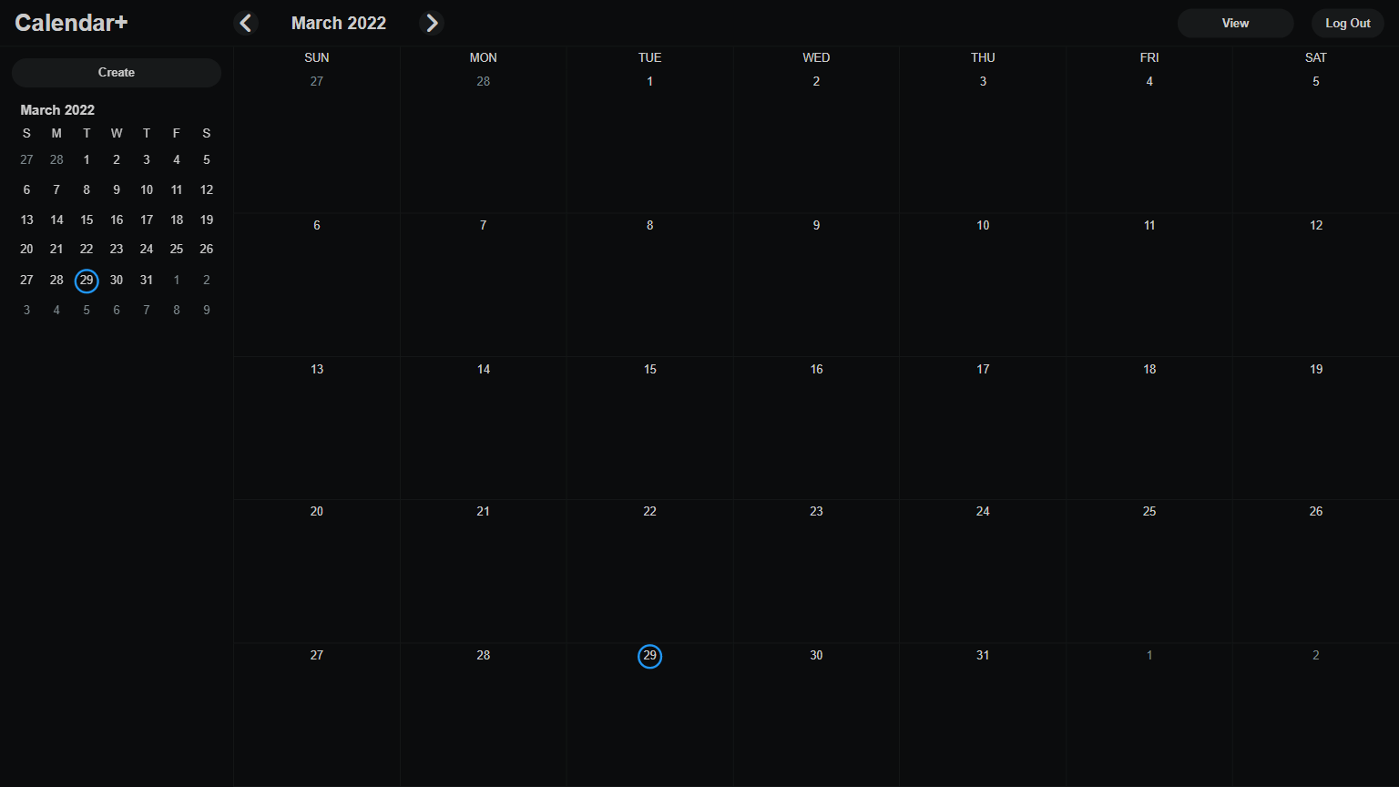
GUI – Changes
Login & Registration Pages Combined
Page now created dynamically through JavaScript
Also added a back button to registration to reflect this change

Slide 5
GUI – Complete
Login & Registration
All forms inputs implemented (with requirements)
Month calendar components
Set of functions used in any view that contains a month calendar
Top nav bar
Current viewed date displayed + ability to change to previous or next
Dropdown to select view
Year view
Month view

Slide 6
GUI – Partially Complete
Sidebar
2 of 3 views “complete”
Event creation form currently does nothing
Still need to implement event information view
Mini month calendar has no buttons to change date, will be added soon
Day View
Functions to track and display the current day are implemented and work as expected
Styling
Mostly complete, aside from a few placeholders
Has been updated as the project has been developed.

Slide 7
GUI – Still Need to Implement
Week view
Can potentially reuse day view’s code, so shouldn’t be too much of a challenge.
Schedule view
Can’t implement fully until events can be added and pulled from the database.
Display events on calendars
Presentation layer? (basically an invisible grid on top of the already existing grid for that view)
Sidebar
Make collapsible (shouldn’t be too hard, but not high on priority list)
“Event information view”
Still need to implement a form to add reminders to events

Slide 8
GUI – Potential Issues
Displaying events correctly may pose a challenge?
Would probably have to be done through a presentation layer, to allow events to be displayed in more than one cell continuously.
In theory, not too difficult; main issue lies with figuring out the logic of getting them to display correctly (i.e. starting and ending in the correct cells, not overlapping other events).

Slide 9
Node.js Modules - Changes
Express
Server-side web application framework
Morgan
Middleware to log HTTP requests and errors
Bodyparser
Allows express to read HTTP POST requests
Mysql
Allows Express and Node.js to interact with the database
Express-session
Server-side framework to manage a session
Nodemon
Tool to help Node.js development

Slide 10
Node.js HTTP requests - Currently Implemented
Implemented the POST request for registration
User data stored in SQL database
Implemented the POST request for login
Session data stored

Slide 11
Node.js HTTP requests - To be Implemented
POST request to insert event data into database
Should be easy to implement
POST request to update event data*
Request to get event data from database to render or show*

Slide 12
Displaying Events - To be Implemented/Potential Issue
Currently no route in our Express backend sends the correct events from the database to be displayed depending on the user selected timeframe
Issue is compounded by the fact that navigation within the calendar is entirely frontend-driven, with no backend input
One potential solution is to serve calendar views via GET requests
Use GET parameters (req.params in Express) to determine which event data to send to the frontend.

Slide 13
Events/Reminders- To be implemented/Potential Issues
Colors for events
Web-push module
VAPID keys
Service-workers
Subject to change

Slide 14
Hosting Server- Potential Issue
Running on local machines
Have not pushed anything to actual server
Could be some unexpected troubles

Slide 15
Time - Potential Issue
Time can always be an issue
Balance
Time to fix errors

Slide 16
Conclusion
We have covered:
GUI
Changes
What’s been completed
Partially completed
Still to be completed
Node.js modules
Node.js HTTP requests
Things to be implemented and possible issues
Displaying events
Events and connection to reminder system
Hosting server
Thank you for listening.
Any questions?

